Slide 1
CODE Session – JDBC
By Aaron Korver

Slide 2

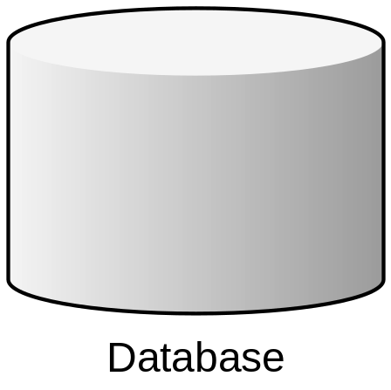
JDBC is used to retrieve database information within Java

Slide 3

Developers struggle with the complexity of the JDBC API

Slide 4




Incorrect use of JDBC can cause application problems

Slide 5


Understanding the JDBC API will help you prevent these problems

Slide 6

Follow along as we journey into the depths of JDBC

Slide 7
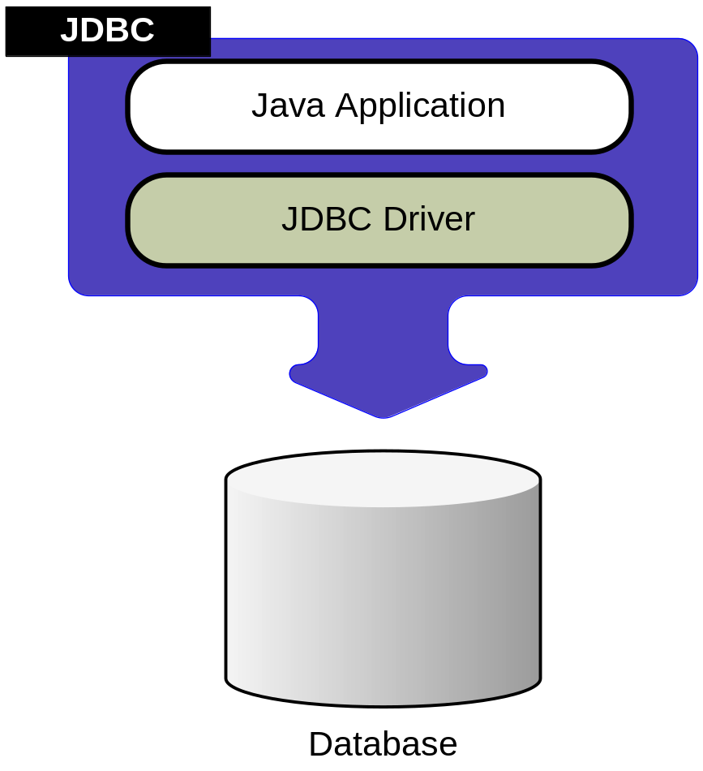
Basic JDBC

Slide 8

Drivers
2
3
4
1

Slide 9
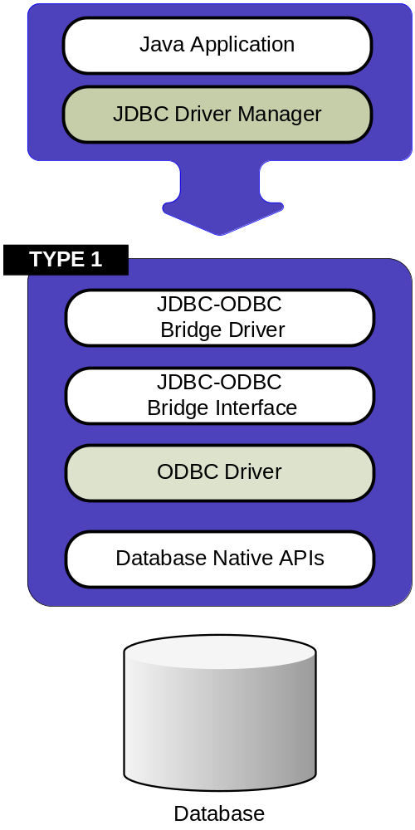

Slide 10
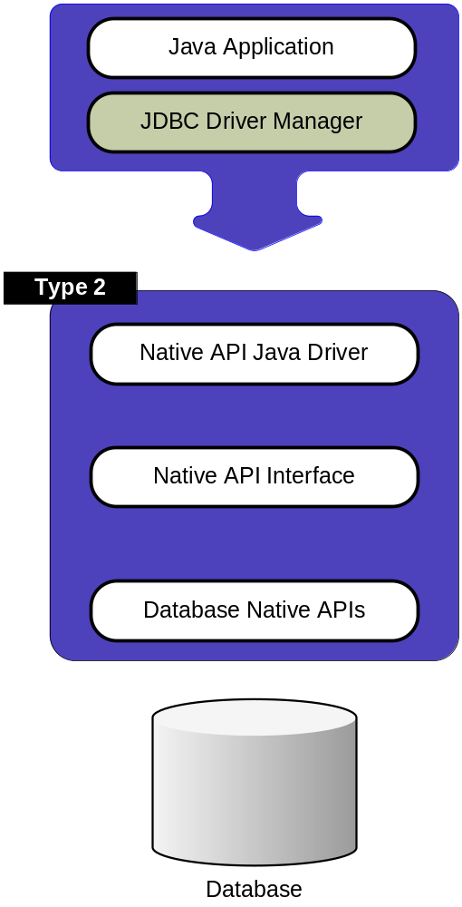

Slide 11
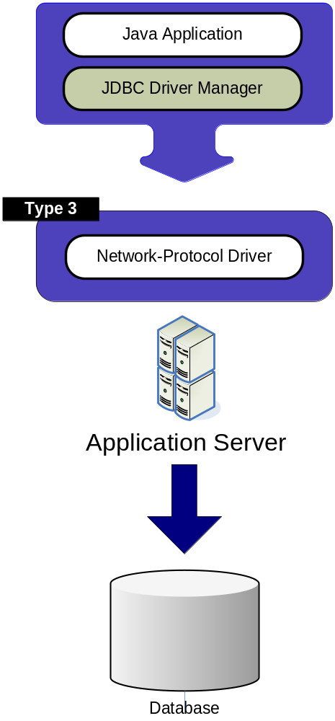

Slide 12
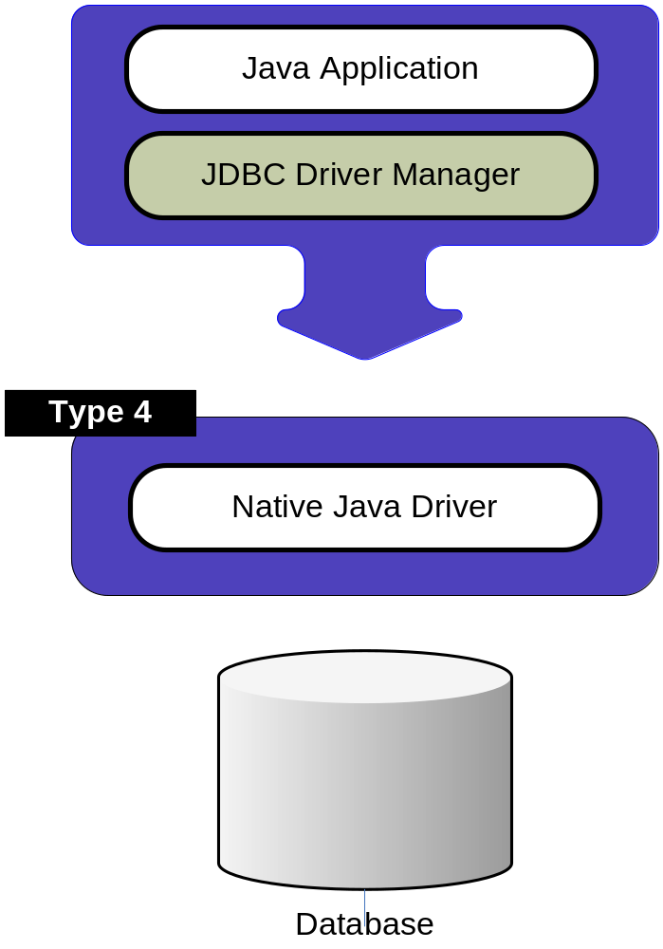

Slide 13
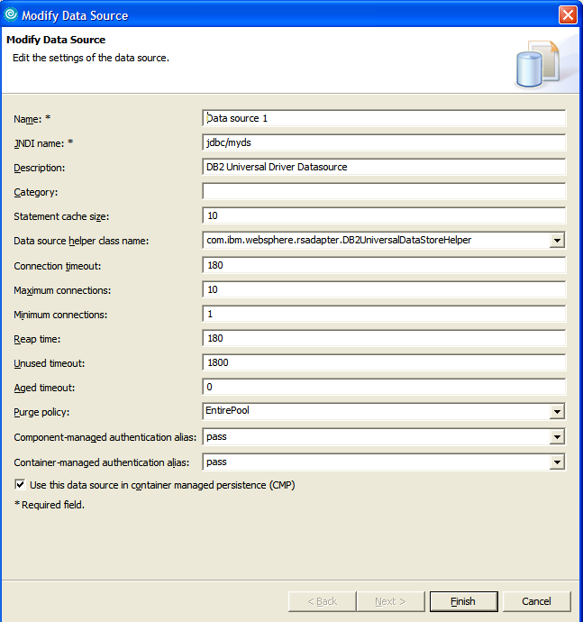
Datasources
public DataSource getDataSource() {
try{
InitialContext ic = new InitialContext();
DataSource ds = (DataSource)ic.lookup(“jdbc/myds”);
}
catch(NamingException ex){ logger.error(“Can’t lookup datasource jdbc/myds”.);
}
}
Notes:
A datasource is a logical abstraction of a database. So it is kinda a fuzzy abstract thing that Java developers get to interact with. It has properites such as name, servername, port number, user name, password, etc

Slide 14
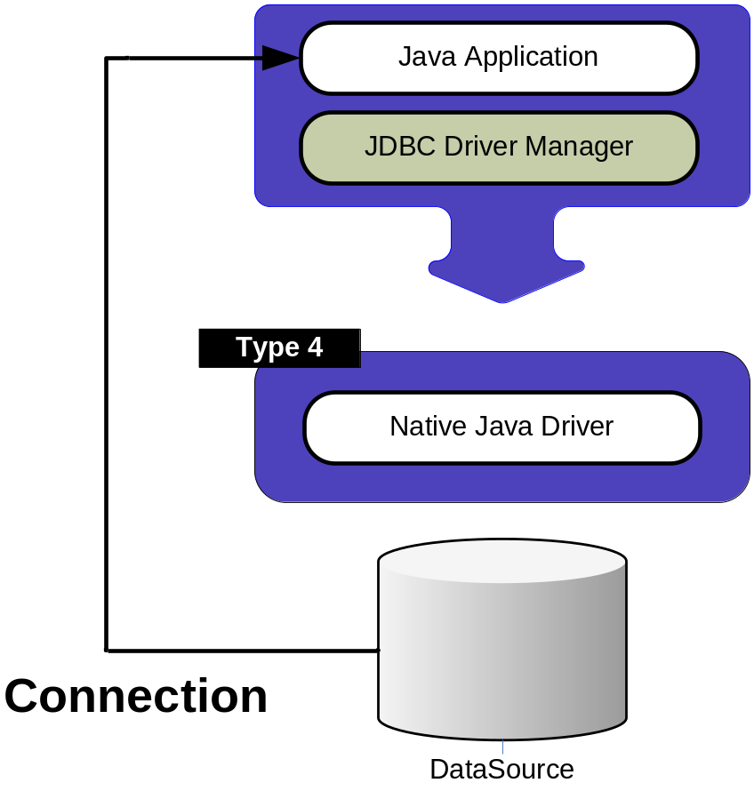
Connection
public String getName(){
Connection conn = null;
try{
conn = getDataSource().getConnection();
…..
}catch(SQLException sqlExc){
logger.error(“Problem getting name.”,sqlExc);
}
finally{
try{
if(conn != null) { conn.close(); }
} catch(SQLException sqlExc){
logger.error(“Problem closing connection”,sqlExc);
}
}
Notes:
It should be noted that this is a Managed connection since it is grabbing the datasource from JNDI (see previous slide).

Slide 15
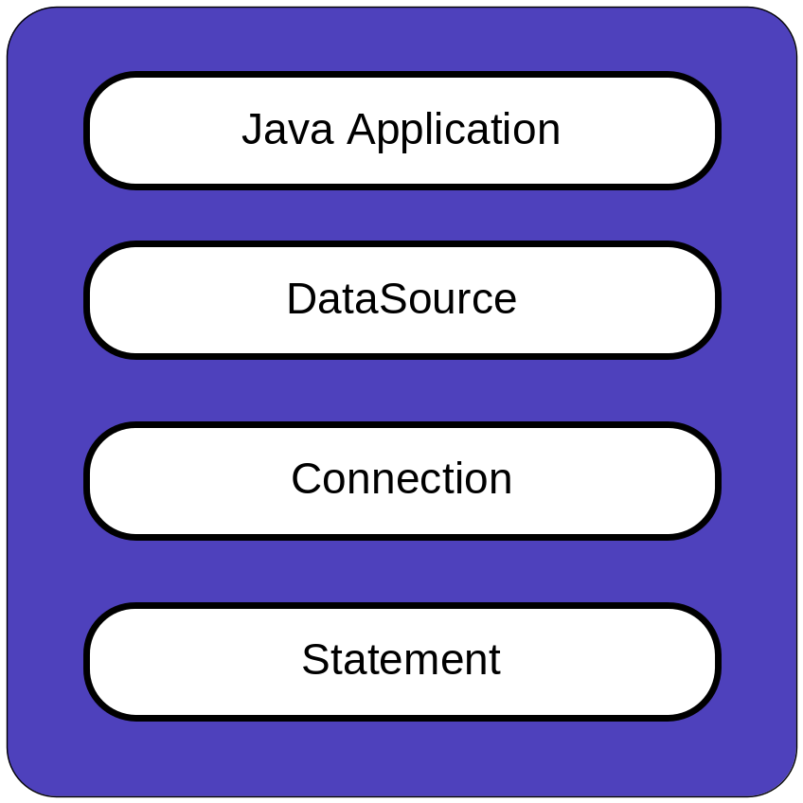
Statement
public void callDatabase(){
Connection conn = null;
Statement stmt = null;
try{
….
stmt = conn.createStatement();
…..
}catch(SQLException sqlExc){
logger.error(“Problem getting name.”,sqlExc);
}
finally{
try{
if(stmt != null) { stmt.close(); }
} catch(SQLException sqlExc){
logger.error(“Problem closing statement”,sqlExc);
}
//conn close code goes here
}

Slide 16
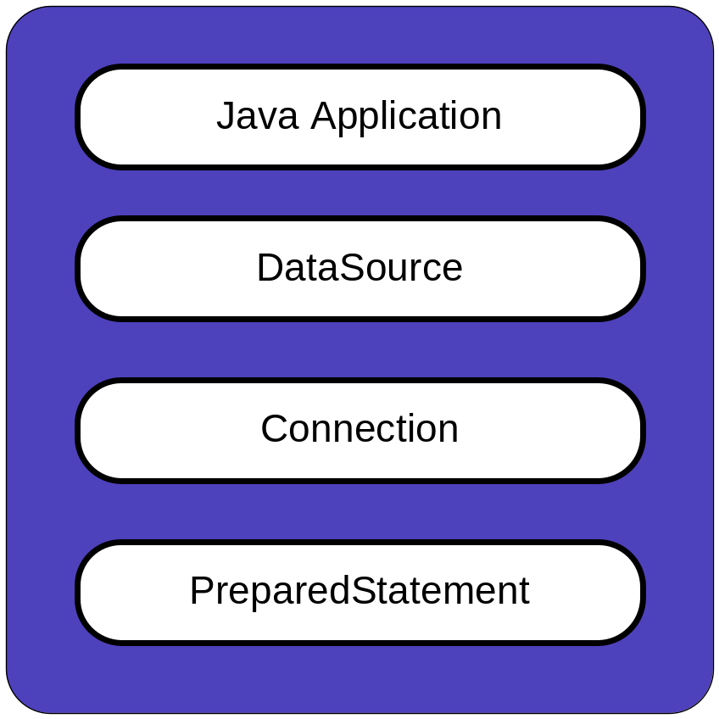
PreparedStatement
public void callDatabase(){
Connection conn = null;
PreparedStatement stmt = null;
try{
….
String sql = “Select name from table where id=?”;
stmt = conn.prepareStatement(sql);
stmt.setString(1,”00002321”);
…..
}catch(SQLException sqlExc){
logger.error(“Problem getting name.”,sqlExc);
}
finally{
try{
if(stmt != null) { stmt.close(); }
} catch(SQLException sqlExc){
logger.error(“Problem closing statement”,sqlExc);
}
//conn close code goes here
}

Slide 17
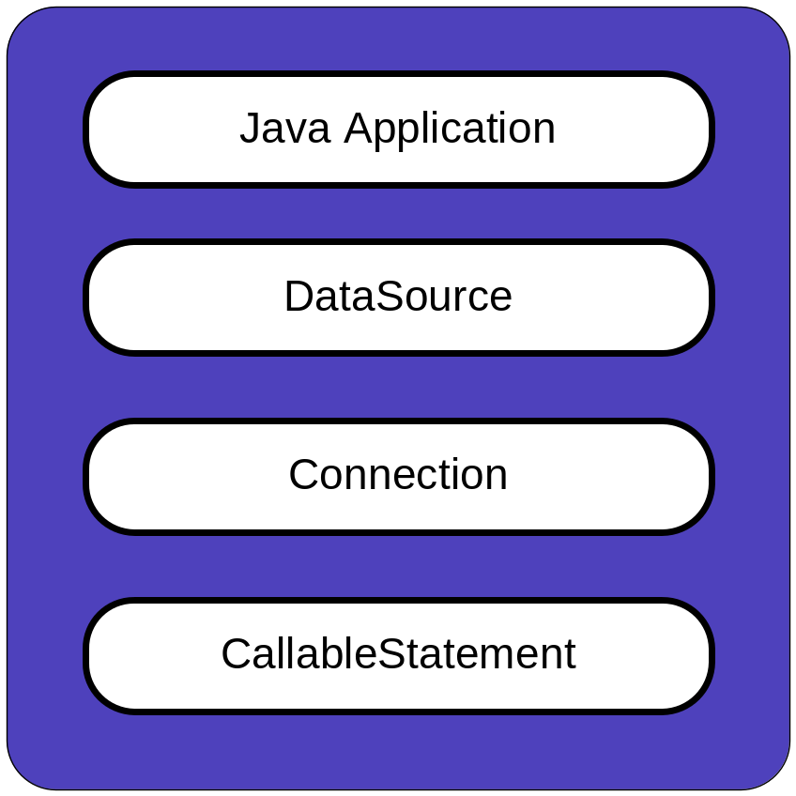
CallableStatement
public void callDatabase(){
Connection conn = null;
CallableStatement stmt = null;
try{
….
String sql = “{? = CALL MYSP(?)}”;
stmt = conn.prepareCall(sql);
stmt.registerOutParameter(1,Types.String);
stmt.setString(“00002321”);
…..
}catch(SQLException sqlExc){
logger.error(“Problem getting name.”,sqlExc);
}
finally{
try{
if(stmt != null) { stmt.close(); }
} catch(SQLException sqlExc){
logger.error(“Problem closing statement”,sqlExc);
}
//conn close code goes here
}

Slide 18
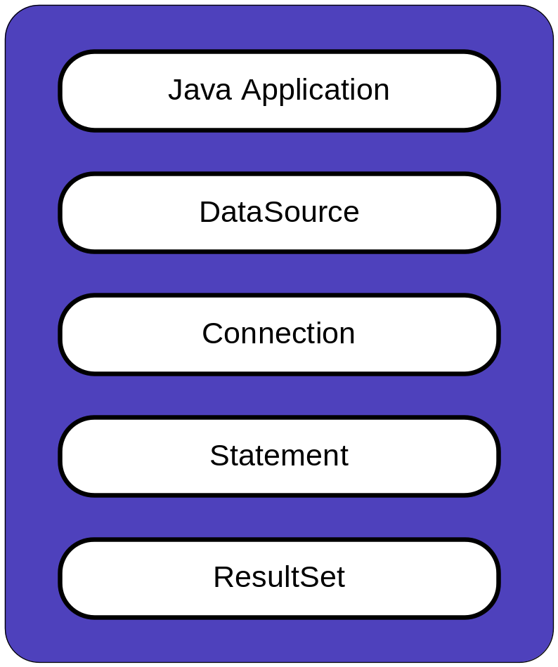
ResultSet
public void callDatabase(){
Connection conn = null;
PreparedStatement stmt = null;
ResultSet rs = null;
try{
….
String sql = “Select name from table where id=?”;
…..
logger.debug(“Executing statement [“ + sql +”]”);
rs = stmt.executeQuery();
while(rs.next()) {
name = rs.getString(“name”);
}
}catch(SQLException sqlExc){
logger.error(“Problem getting name.”,sqlExc);
}
finally{
try{
if(rs != null) { rs.close(); }
} catch(SQLException sqlExc){
logger.error(“Problem closing resultSet”,sqlExc);
}
//stmt close code goes here
//conn close code goes here
}
Notes:
Note that I’m retrieving the column via a name, not a number. This is to prevent changes incase of a reordering of the query or adding additional fields.

Slide 19
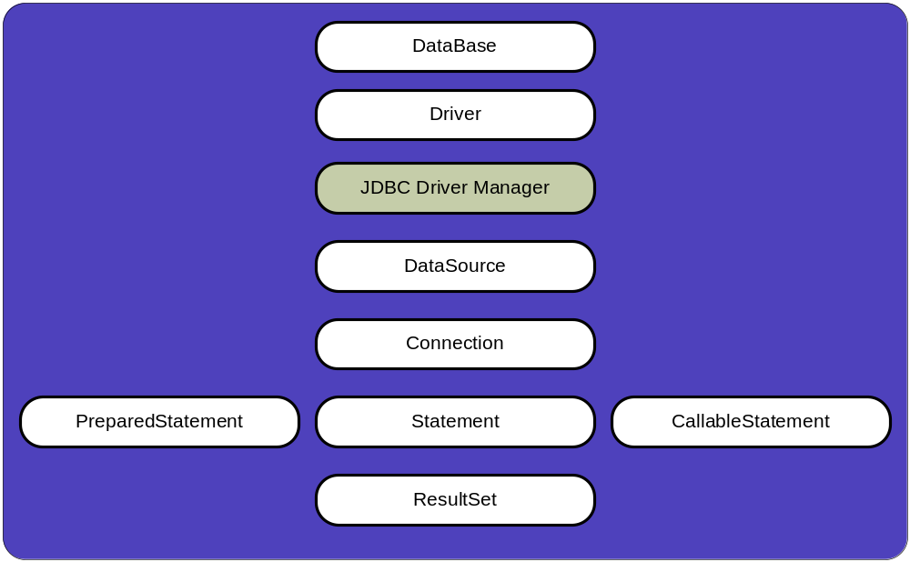
JDBC Summary

Slide 20
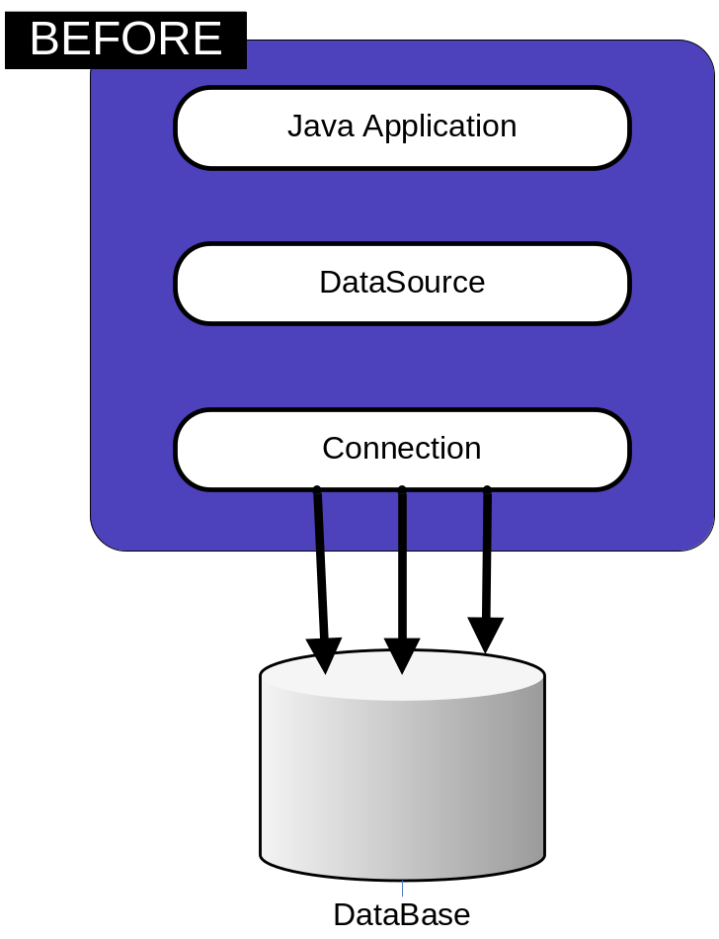
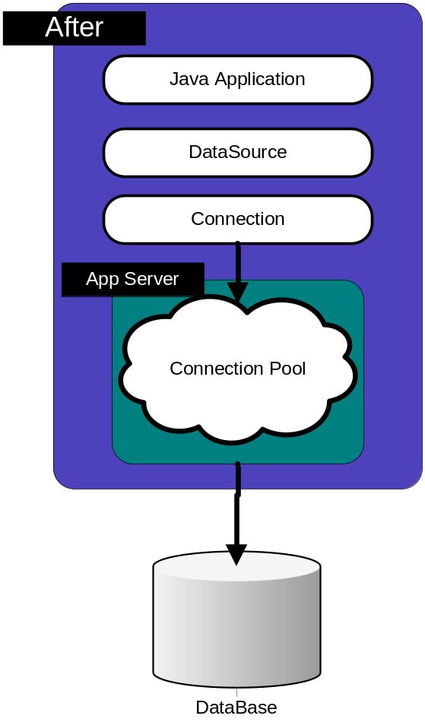
Connection Pooling

Slide 21
JDBC “Best” Practices
Close resources in the same place you created them.
Batch insert/update.
try/catch/finally
Use a connection pool
Don’t use SELECT *
Use PreparedStatements
Use get*() instead of getObject()

Slide 22
Close your resources!
finally
{
try {
if(rs != null) {rs.close();}
} catch (SQLException e3) {
logger.error(“Problem closing ResultSet”,e3);}
try {
if(ps != null) {ps.close();}
} catch (SQLException e1) {
logger.error(“Problem closing Statement”,e3);}
try {
if(conn != null) {conn.close();}
} catch (SQLException e2) {
logger.error(“Problem closing Connection”,e3); }
}

Slide 23
Don’t Repeat Yourself (D.R.Y)
public class DBUtil {
public static void close(Connection conn) {
try {
if(conn != null) {conn.close();}
} catch (SQLException e2) {
logger.error(“Problem closing Connection”,e3);} }
public static void close(Statement stmt) {
try {
if(ps != null) {ps.close();}
} catch (SQLException e1) {
logger.error(“Problem closing Statement”,e3);}}
public static void close(ResultSet rs) {
try {
if(rs != null) {rs.close();}
} catch (SQLException e3) {
logger.error(“Problem closing ResultSet”,e3);}}
}
Now your code becomes….
finally {
DBUtil.close(resultSet);
DBUtil.close(statement);
DBUtil.close(connection);
}
Notes:
Or…you could just use Spring and the JDBCTemplate.

Slide 24
Batch Insert/Update Example
PreparedStatement stmt = con.prepareStatement( "INSERT INTO employees VALUES (?, ?)");
stmt.setInt(1, 2000);
stmt.setString(2, "Kelly Kaufmann");
stmt.addBatch();
stmt.setInt(1, 3000);
stmt.setString(2, "Bill Barnes");
stmt.addBatch();
// submit the batch for execution
int[] updateCounts = stmt.executeBatch();

Slide 25
Advanced Tip for Generated Keys
String SQL = “INSERT INTO……”;
pstmt = conn.prepareStatement(SQL,
Statement.RETURN_GENERATE_KEYS);
……
ps.execute();
ResultSet keys = ps.getGeneratedKeys();
while(keys.next())
logger.info(keys.getBigDecimal(1));
…..
Notes:
The key will always be of type BigDecimal regardless of how it is declared within the DB

Slide 26
BONUS Material

Slide 27
Phantom Reads
Id | Name | Age
1 | Joe | 20
2 | Jill | 25
/* Transaction 1 */
/* Query 1 */
SELECT * FROM users WHERE
age BETWEEN 10 AND 30;
/* Query 1 */
SELECT * FROM users WHERE
age BETWEEN 10 AND 30;
/* Transaction 2*/
/* Query 2 */
INSERT INTO users VALUES
( 3, 'Bob', 27 );
COMMIT;
Notes:
A phantom read occurs when, in the course of a transaction, two identical queries are executed, and the collection of rows returned by the second query is different from the first. This can occur when range locks are not acquired on performing a SELECT.

Slide 28
Non-Repeatable Read
Id | Name | Age
1 | Joe | 20
2 | Jill | 25
/* Transaction 1 */
/* Query 1 */
SELECT * FROM users WHERE id = 1;
/* Query 1 */
SELECT * FROM users WHERE id = 1;
/* Transaction 2 */
/* Query 2 */
UPDATE users SET age = 21 WHERE id = 1;
COMMIT;
Notes:
In this example, Transaction 2 commits successfully, which means that its changes to the row with id 1 should become visible. However, Transaction 1 has already seen a different value for age in that row. At the SERIALIZABLE and REPEATABLE READ isolation level, the DBMS must return the old value. At READ COMMITTED and READ UNCOMMITTED, the DBMS may return the updated value; this is a non-repeatable read.

Slide 29
Dirty Read
Id | Name | Age
1 | Joe | 20
2 | Jill | 25
/* Transaction 1 */
/* Query 1 */
SELECT * FROM users WHERE id = 1;
/* Query 1 */
SELECT * FROM users WHERE id = 1;
/* Transaction 2 */
/* Query 2 */
UPDATE users SET age = 21 WHERE id = 1;
Notes:
The only difference between Non-Repeatable Read and Dirty Read is that there is NO COMMIT issued during Transaction #2, yet Transaction #1 still sees the updated record.

Slide 30
ANSI Isolation Levels
Isolation Level | Dirty Read | Non-repeatable Read | Phantom Read
READ UNCOMMITTED | Permitted | Permitted | Permitted
READ COMMITTED | -- | Permitted | Permitted
REPEATABLE READ | -- | -- | Permitted
SERIALIZABLE | -- | -- | --
Notes:
The Isolation Level is a property of a connection.

Slide 31
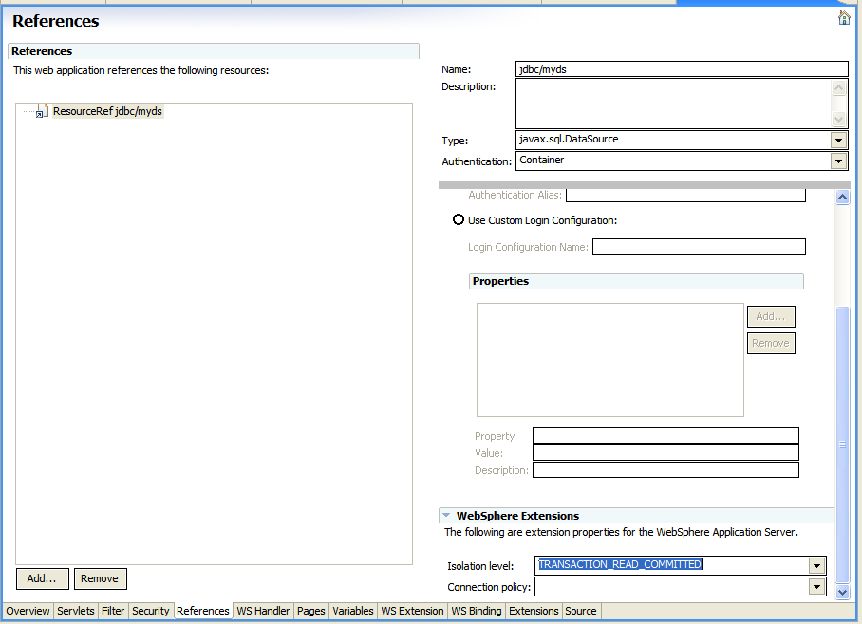
Setting the Isolation Level
Notes:
You get to this screen from inside of RAD, double-click the web.xml file to open this GUI editor.

